Slide 1
MORGAN’S MESSAGE
x WMS PTA

Slide 2
WELCOME
Who are we?
What is Morgan’s Message?
Why was Morgan’s Message created?

Slide 3
MM VIDEO

Slide 4
Our Mission
Our Vision
Morgan’s Message amplifies stories, resources, and expertise to confront student-athlete mental health, builds a community by and for athletes, and provides a platform for advocacy.
Morgan’s Message strives to eliminate the stigma surrounding mental health within the student-athlete community and equalize the treatment of physical and mental health in athletics. We aim to expand the dialogue on mental health by normalizing conversations, empowering those who suffer in silence, and supporting those who feel alone.

Slide 5
TABLE OF CONTENTS
01
02
03
MORGAN’S STORY
SUBTLE SIGNS
WHAT CAN YOU DO?

Slide 6
01
MORGAN’S STORY

Slide 7
MORGAN’S STORY - TIMELINE
2015 -
2016
SPRING
2017
SPRING
2018
SPRING
2019
SOPHOMORE FALL
JUNIOR YEAR
RETURN TO CAMPUS
FRESHMAN YEAR
SOPHOMORE SPRING
MEDICAL LEAVE
LAST SEMESTER
FALL 2016
2017 -
2018
FALL
2018
Breakout Season
Noticeable Changes
College Adjustment
The Injury

Slide 8
02
SUBTLE SIGNS

Slide 9
Common Signs
Withdrawing from social situations
Self-harming - covering up
Drastic or extreme changes in behavior and/or appearance
Noticeable changes in attitude toward previous interests
Repeated use of drugs or alcohol - trying to dull the pain
Sleep habits - too much or not enough
Notes:
Dona and Kurt

Slide 10
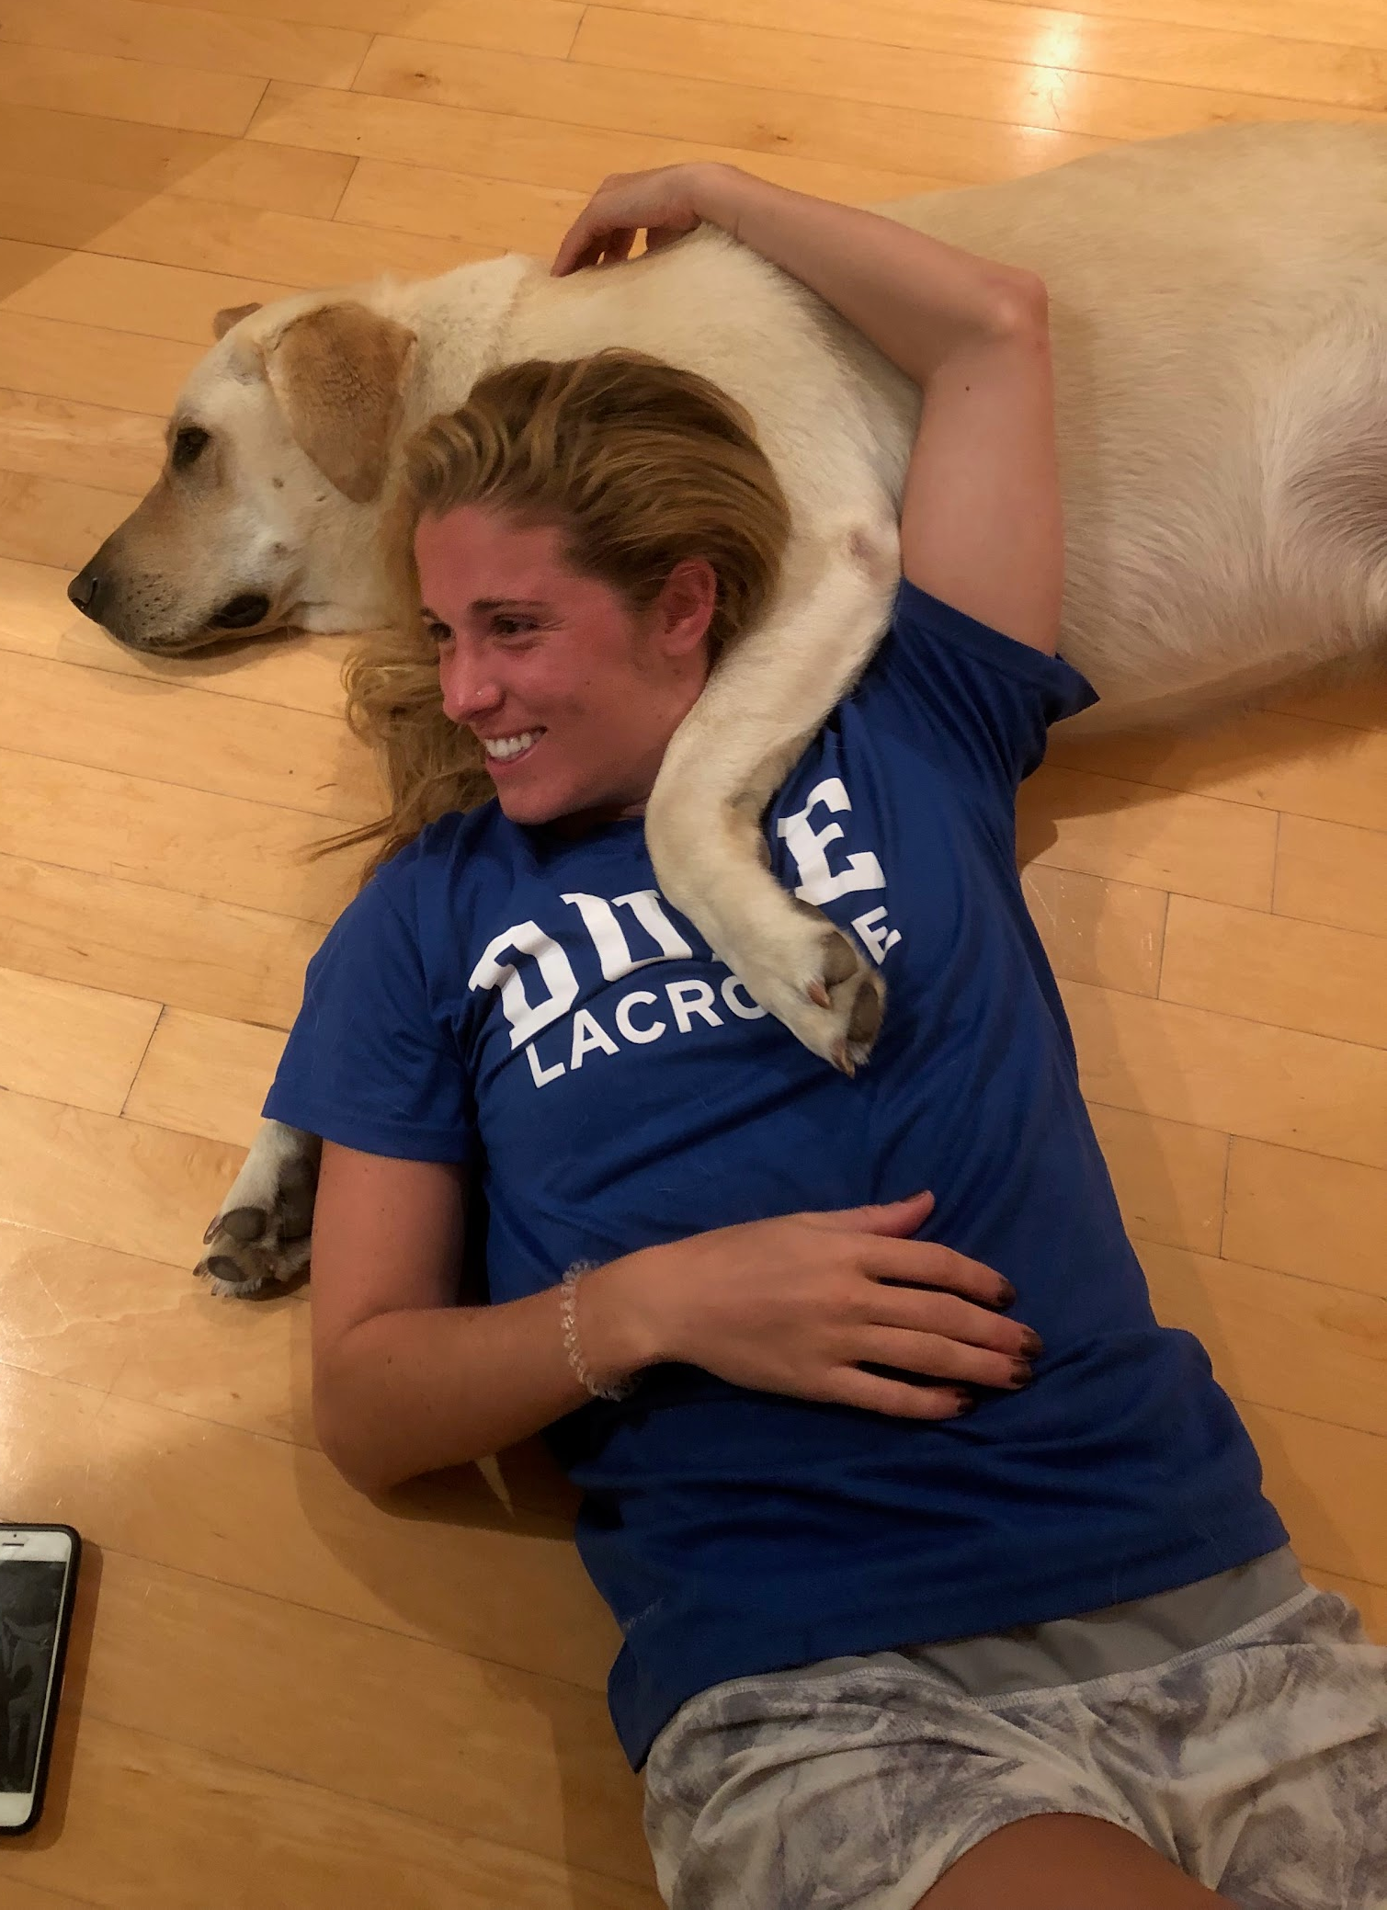
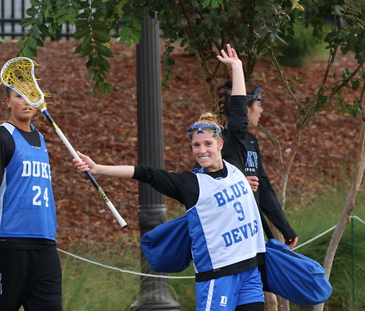
BIG TAKEAWAYS
Mental illness can and will affect anyone
Mental illness is widespread
The ability to hide the pain
Notes:
Dona and Kurt

Slide 11
03
WHAT CAN YOU DO?

Slide 12
Help destigmatize mental health
Language matters - died by suicide
Become comfortable and open with discussions - without judgement
Learn to be a good listener
Model by having conversations about your own mental health
Use “I” statements
I’ve noticed you aren’t hanging with your friends as much
I’ve noticed you’ve seem distracted, sleeping a lot, etc.
Research resources available to you or your child
Notes:
Kat

Slide 13
Our Work
Morgan’s Message Education Program
1981+ ambassadors on 815+ campuses across the US and Canada are active leaders and advocates of student-athlete mental health on their campus and in their communities!
The Mental Matchup: Presented by Morgan’s Message
A podcast and blog where we share stories about the mental health journeys of athletes and those who work with athletes. TMM sheds light on one of the hardest competitions an athlete will face - the matchup against their own mind. Listen to new episodes every Tuesday on Spotify and Apple Podcasts!

Slide 14
QUESTIONS?

Slide 15
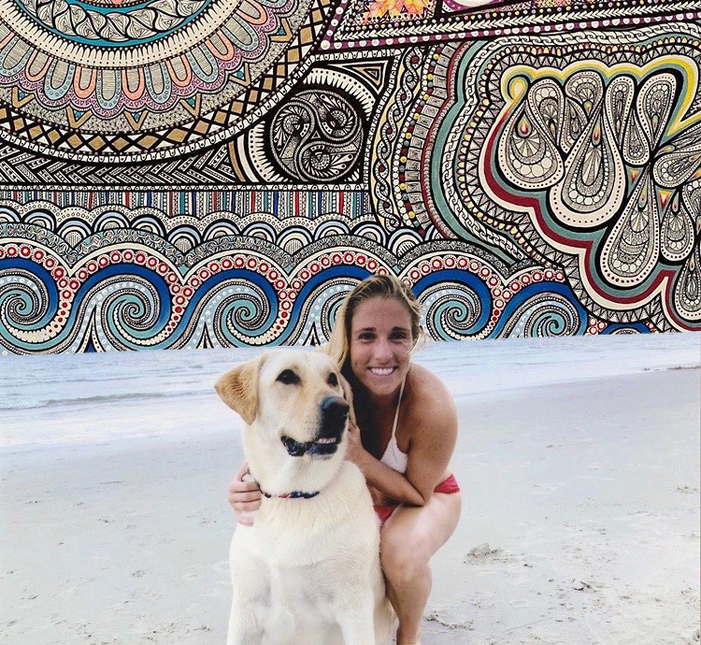

Slide 16
Do you have any questions?
info@morgansmessage.org
dona@morgansmessage.org
education@morgansmessage.org
www.morgansmessage.org
THANK YOU!

